Slide 1

Combinational Circuit

Slide 2
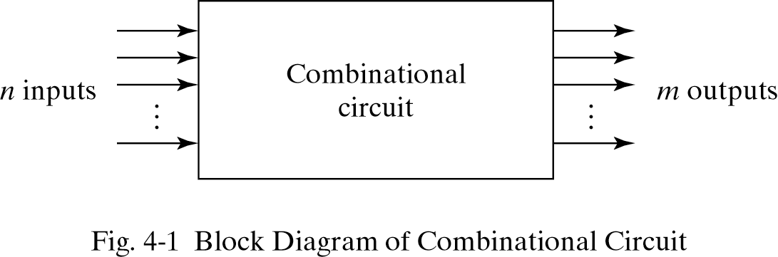
Combinational Circuits
Logic circuits for digital systems may be combinational or sequential.
Combinational Circuits (CC) are circuits made up of by combining different types of logic gates.
A logic gate is a basic building block of any electronic circuit.
The output of the combinational circuit depends on the values at the input at any given time. The circuits do not make use of any memory or storage device.
A combinational circuit consists of input variables, logic gates, and output variables.

Slide 3
Adder
An adder is a digital circuit that is used to perform the addition of numeric values. It is one of the most basic circuits and is found in arithmetic logic units of computing devices.
There are two types of adders:
Half adder
Full adder
Using Multiple Half and Full adders further we will design more bigger circuit:
Binary adder / subtractor
Carry look ahead adder

Slide 4
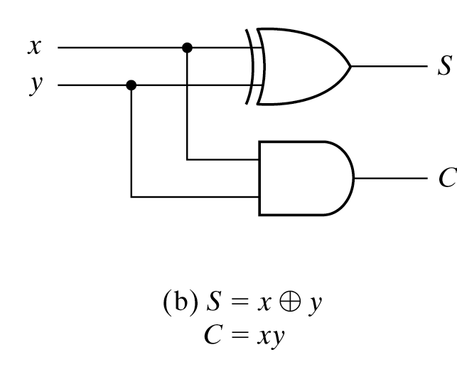
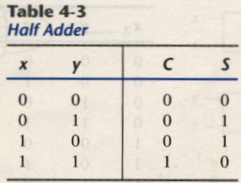
Half Adder
combinational circuit that performs the addition of two bits is
A combinational circuit that performs the addition of two bits is called a half adder.
The truth table for the half adder is listed below:
a half combinational circuit that performs the addition of two bits is called
S: Sum
C: Carry
A combinational circuit that performs the addition of two bits is called
A combinati
S = x’y + xy’= x ⊕ ynal circuit that performs the addition of two bits is called a h C = xyder.
Implementation of Half Adder

Slide 5
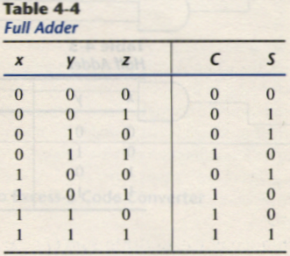
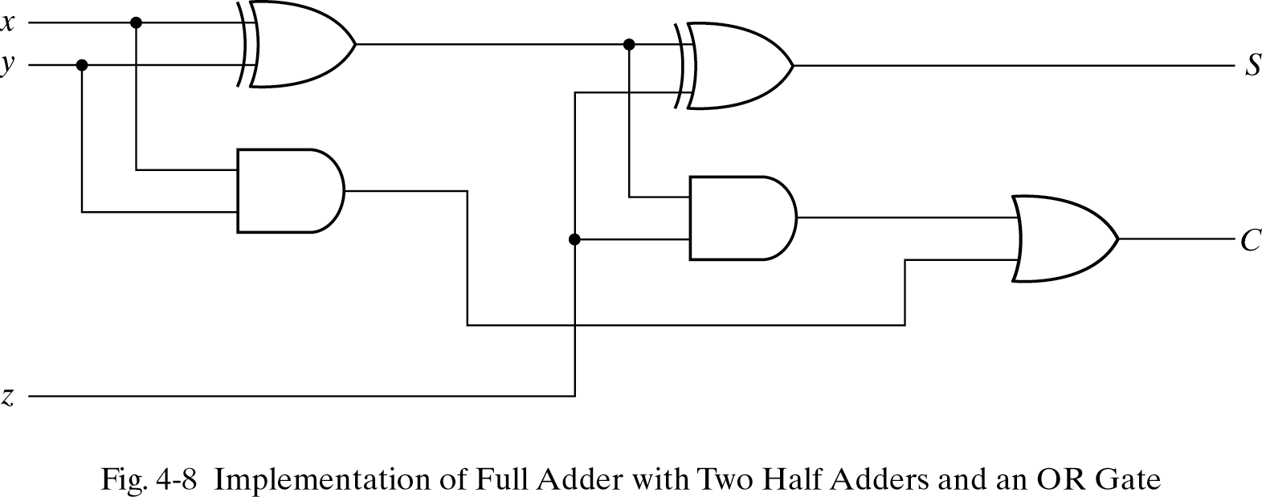
Full Adder
Combinational circuit that performs the addition of three bits(two significant bits and a previous carry) is a full adder.
The truth table for the full adder is listed below:
S = x’y’z + x’yz’ + xy’z’ + xyz
= x ⊕ y ⊕ z = (x ⊕ y) ⊕ z Implementation of full adder
C = x’yz + xy’z + xyz’+ xyz
= z(x’y + xy’) + xy(z’+z)
= (x ⊕ y) z + xy

Slide 6
Thank You

